Slide 1
IMPROVEMENT PROJECT – MATERIAL SPILLAGE CONTROL IN MHS [SMS4]
JSW STEEL | VIJAYANAGAR WORKS
23/02/2026

Slide 2
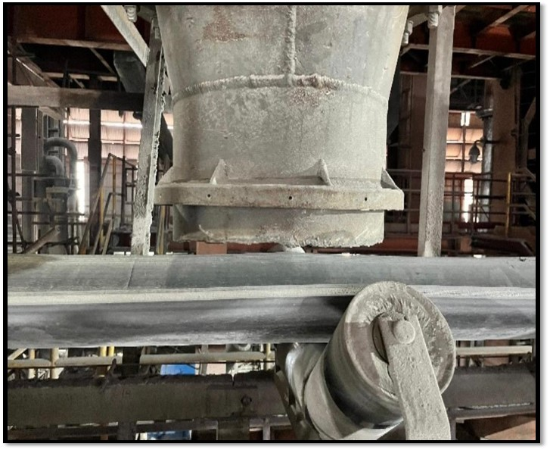
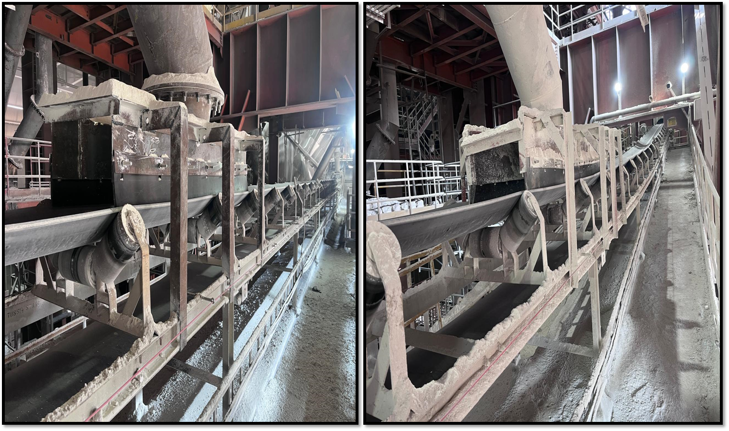
Spillage Control – 5.1 & 5.2 Discharge Chute
Before
After
5.1 DISCHARGE CHUTE
5.2 DISCHARGE CHUTE
Before: No skirt board was installed, which resulted in significant fines and lime spillage during material transfer from 5.1 and 5.2 vibro-feeders to the FARC-1 conveyor, leading to material spillage.
After: New skirt boards were fabricated and installed at both locations, ensuring proper sealing during material transfer. This has eliminated fines and lime spillage.

Slide 3
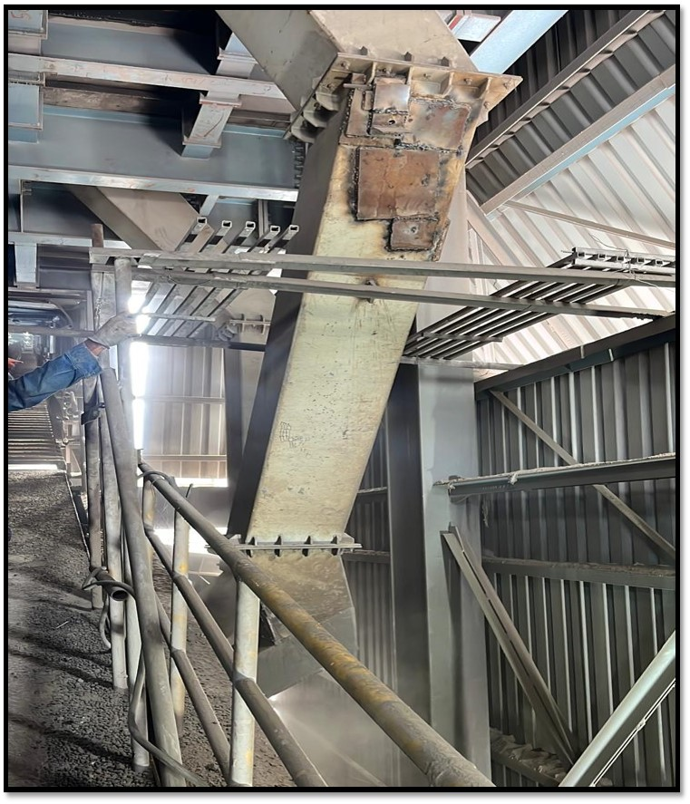
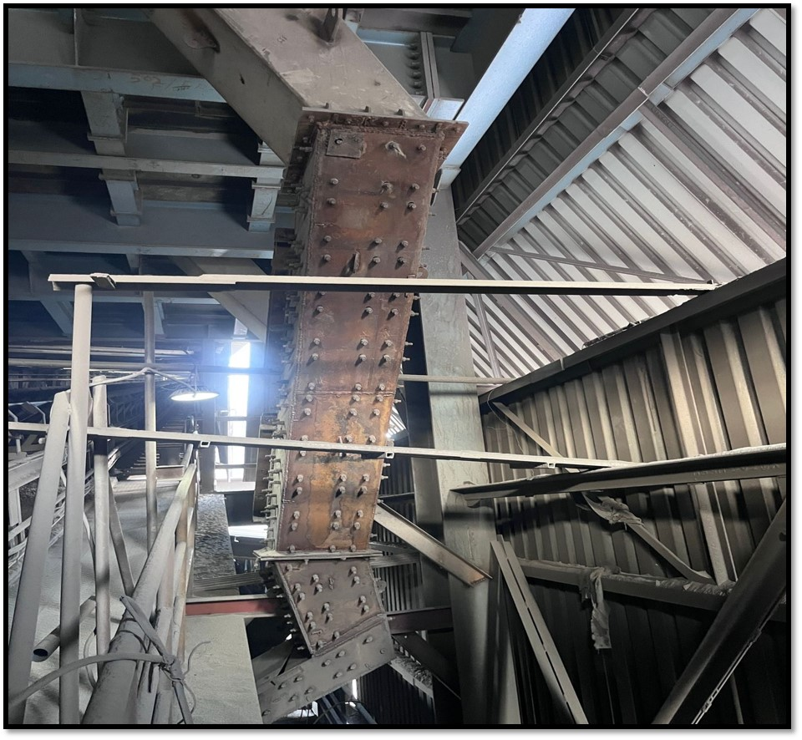
Spillage Control – HAC 1 Discharge Chute
Before
After
REPITATIVE PUNCTURE
NEW DISCHARGE CHUTE
Before: Repetitive puncturing of the HAC-1 discharge chute was causing continuous flux spillage. Previously installed SAIL hard liners were not suitable for flux handling, resulting in frequent damage. Replacement of these liners required at least two days everytime, leading to operational delays and housekeeping issues.
After: The complete chute was replaced with a modified design, and high manganese (High Mn) liners were installed with a CSK bolting arrangement. This modification improved durability and reduced liner replacement time to less than 4 hours, minimizing downtime and preventing flux spillage.

Slide 4
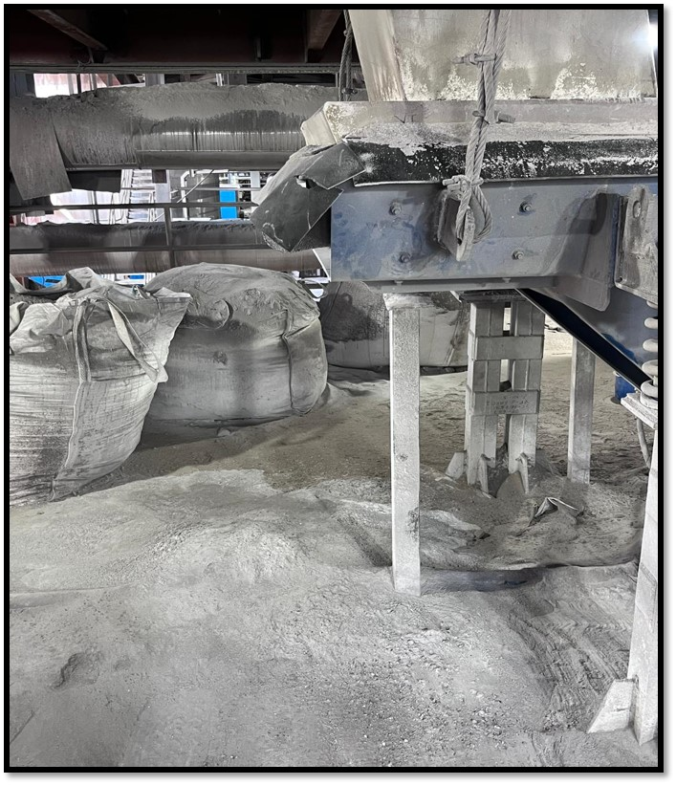
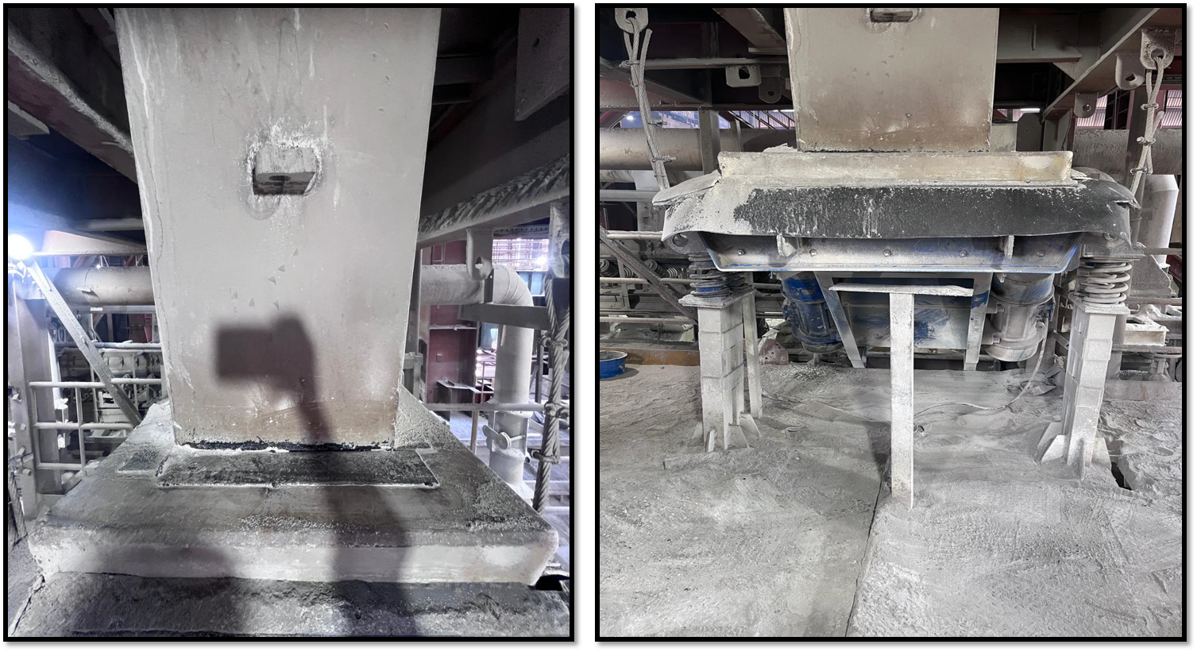
Spillage Control – Vibro Feeder 5
Before
After
Before: Continuous spillage of fine flux particles was observed due to improper covering and sealing of the receiving chute openings, resulting in material leakage.
After: All openings between the vibro-feeder and receiving chute were covered with plates, ensuring proper sealing. This eliminated the leakage path and stopped fines spillage.

Slide 5
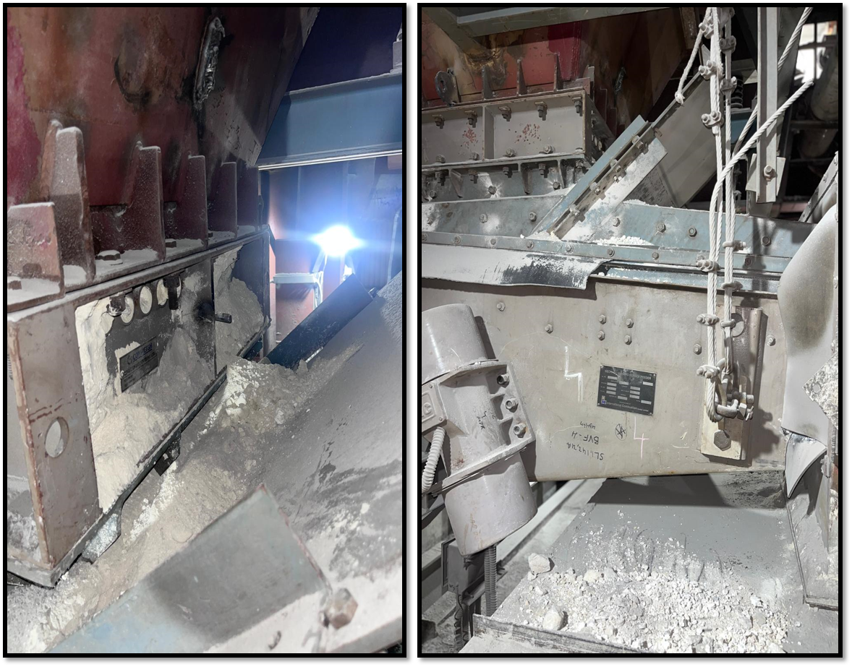
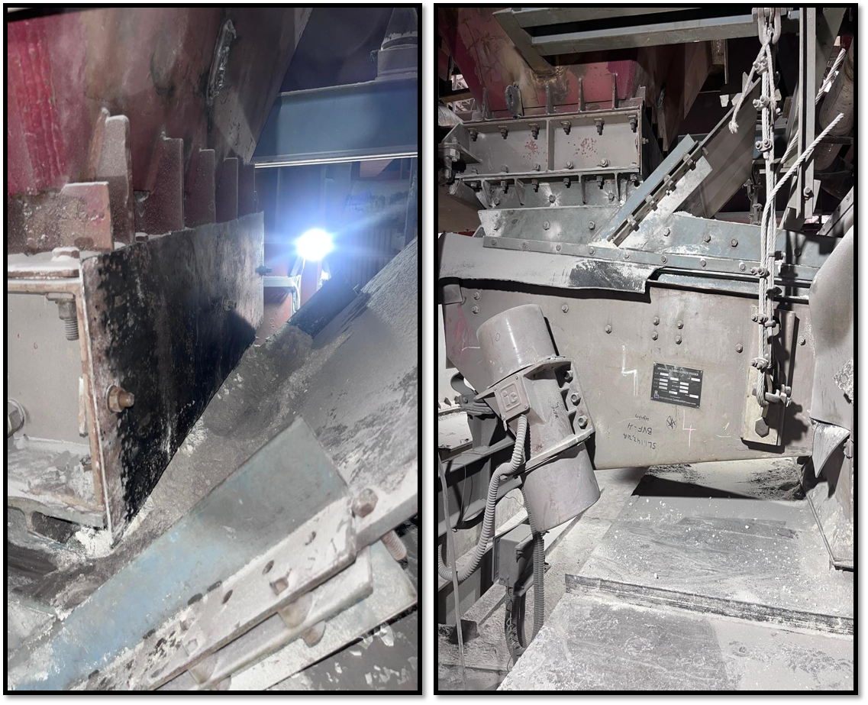
Spillage Control – All Vibro feeder needle gates
Before
After
Before: Continuous fines spillage was observed from the needle gate openings of all 38 installed vibro-feeders, where needles are inserted for bunker isolation. The inadequate sealing at these openings resulted in persistent material leakage and housekeeping issues.
After: Dummy plates with a bolting arrangement were fabricated and installed on all 38 vibro-feeders to seal the needle gate openings. This eliminated fines spillage completely. The dummy plates can be easily removed by unscrewing the bolts whenever needle insertion is required.

Slide 6
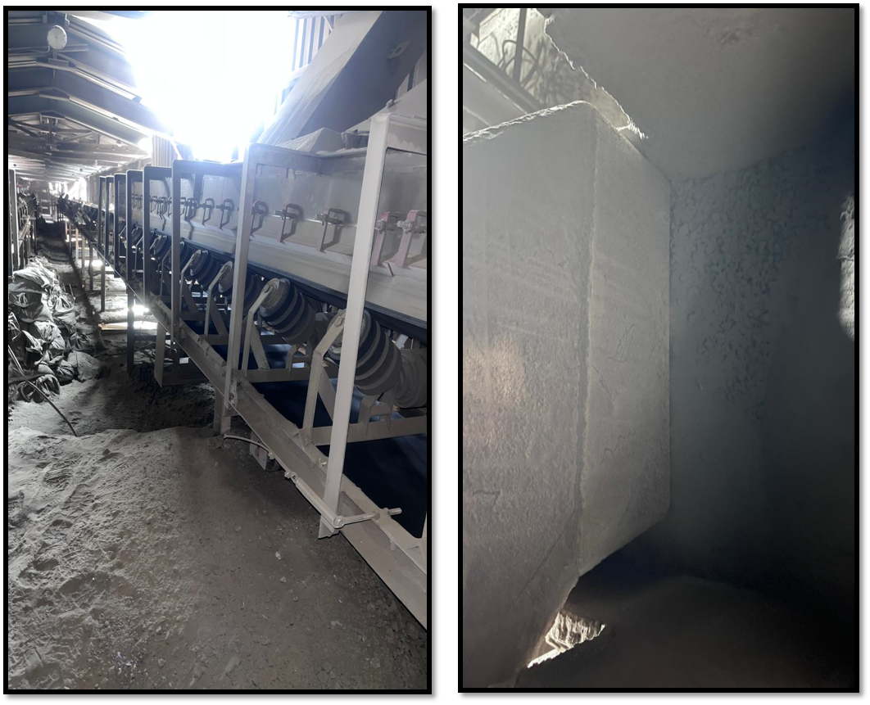
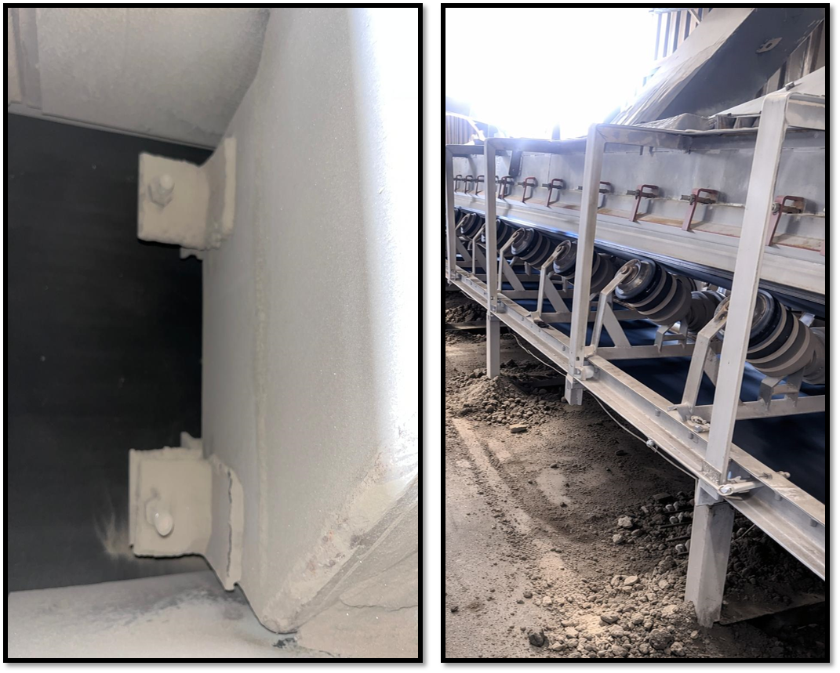
Spillage Control – FAC 1 Tail End Side
Before
After
Restrictor plate
Before: Continuous spillage of fine flux particles.
After: 100mm width restrictor plate fixed inside the receiving chute. Now this has eliminated the spillage.

Slide 7
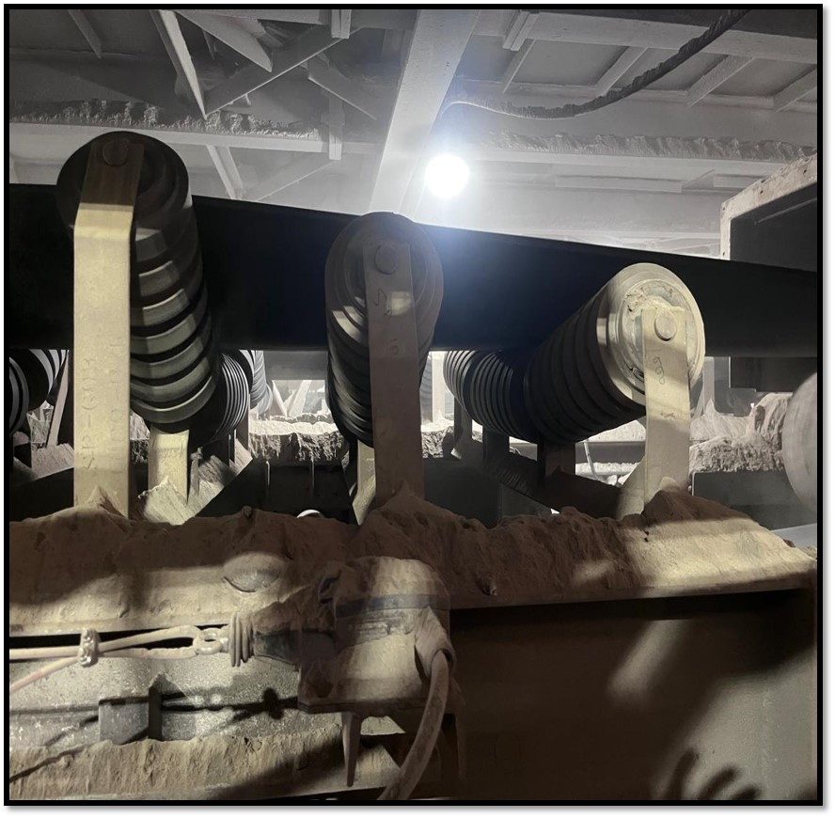
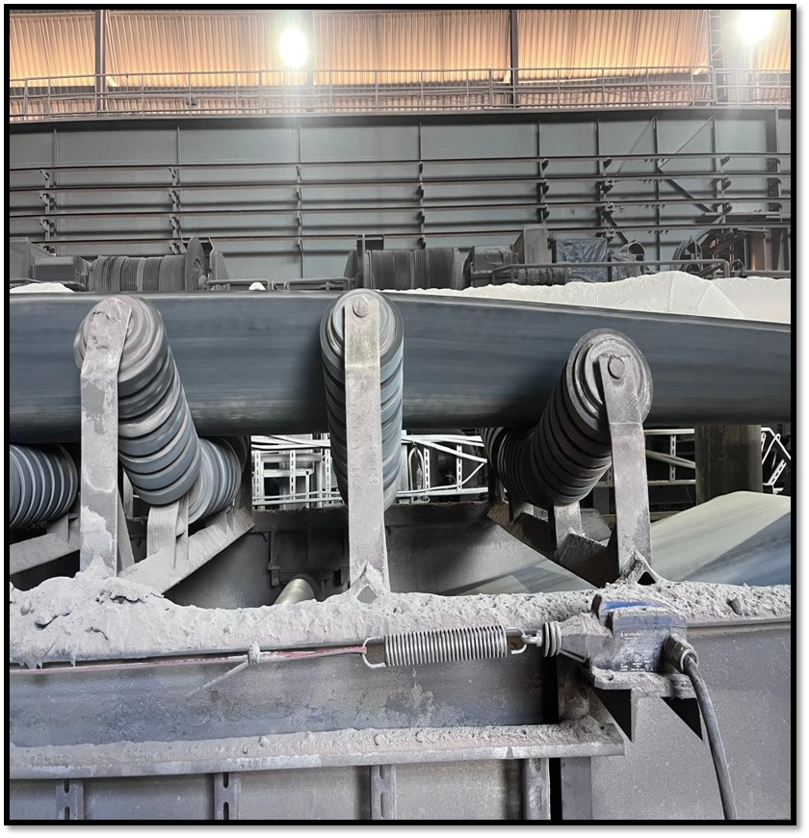
Spillage Control – FAC 1 Tail End Side
Before
After
20 Degree idler frame
35 Degree idler frame
Before: Material and fines spillage was observed near the discharge end on both sides of the conveyor. The BOFRSC discharge end was positioned close to the receiving chute where transition frames were installed, resulting in a gap between the skirt and conveyor belt. This improper sealing led to continuous material spillage.
After: One transition frame was removed and a 35° frame was installed, which reduced the gap between the skirt and conveyor belt. This modification eliminated the leakage path and successfully stopped fines and material spillage at the discharge end.

Slide 8
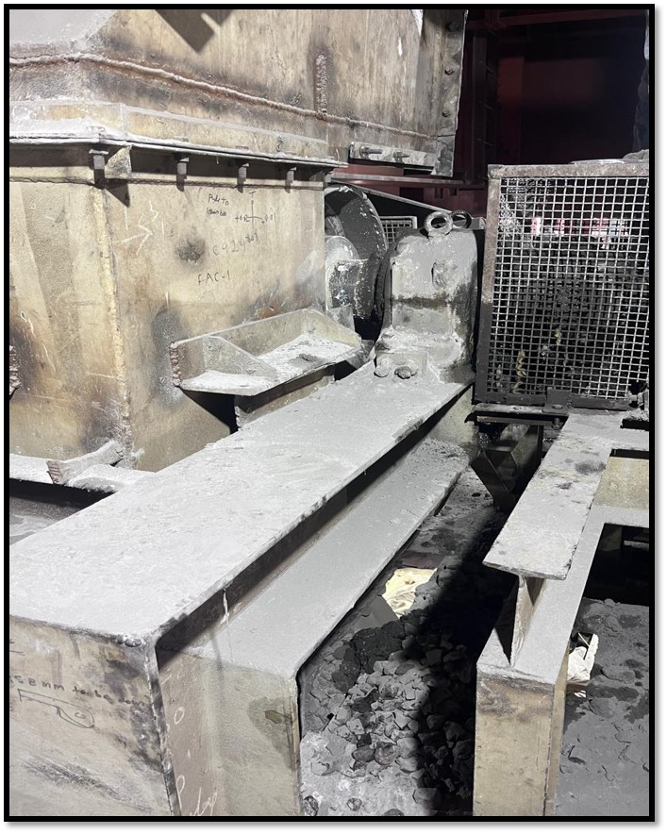
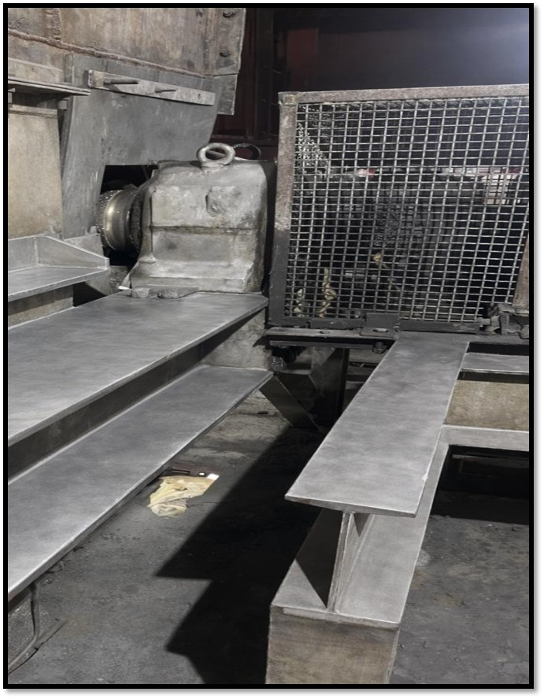
Spillage Control – FAC 1 Tail End Side
Before
After
New Skirt Rubber
Before: Material and fines spillage was observed near the discharge end on both sides of the conveyor. The BOFRSC discharge end was positioned close to the receiving chute where transition frames were installed, resulting in a gap between the skirt and conveyor belt. This improper sealing led to continuous material spillage.
After: One transition frame was removed and a 35° frame was installed, which reduced the gap between the skirt and conveyor belt. This modification eliminated the leakage path and successfully stopped fines and material spillage at the discharge end.

Slide 9
THANK YOU

